Slide 1

Greek Literature in the Era of
the Atheno-Peloponnesian Wars
(431–404 BCE)
Hecataeus of Miletus (II): Periodos Gês, Herodotean ‘Plagiarism’ and Criticism
Prof. Dr. Ruobing Xian
SPRING SEMESTER 2026

Slide 2

01
Fragments of Hecataeus’ Periodos Gês
02
Contents
Herodotus’ Book 2 and Hecataeus of Miletus
03
Hecataeus’ List of Nile Islands

Slide 3

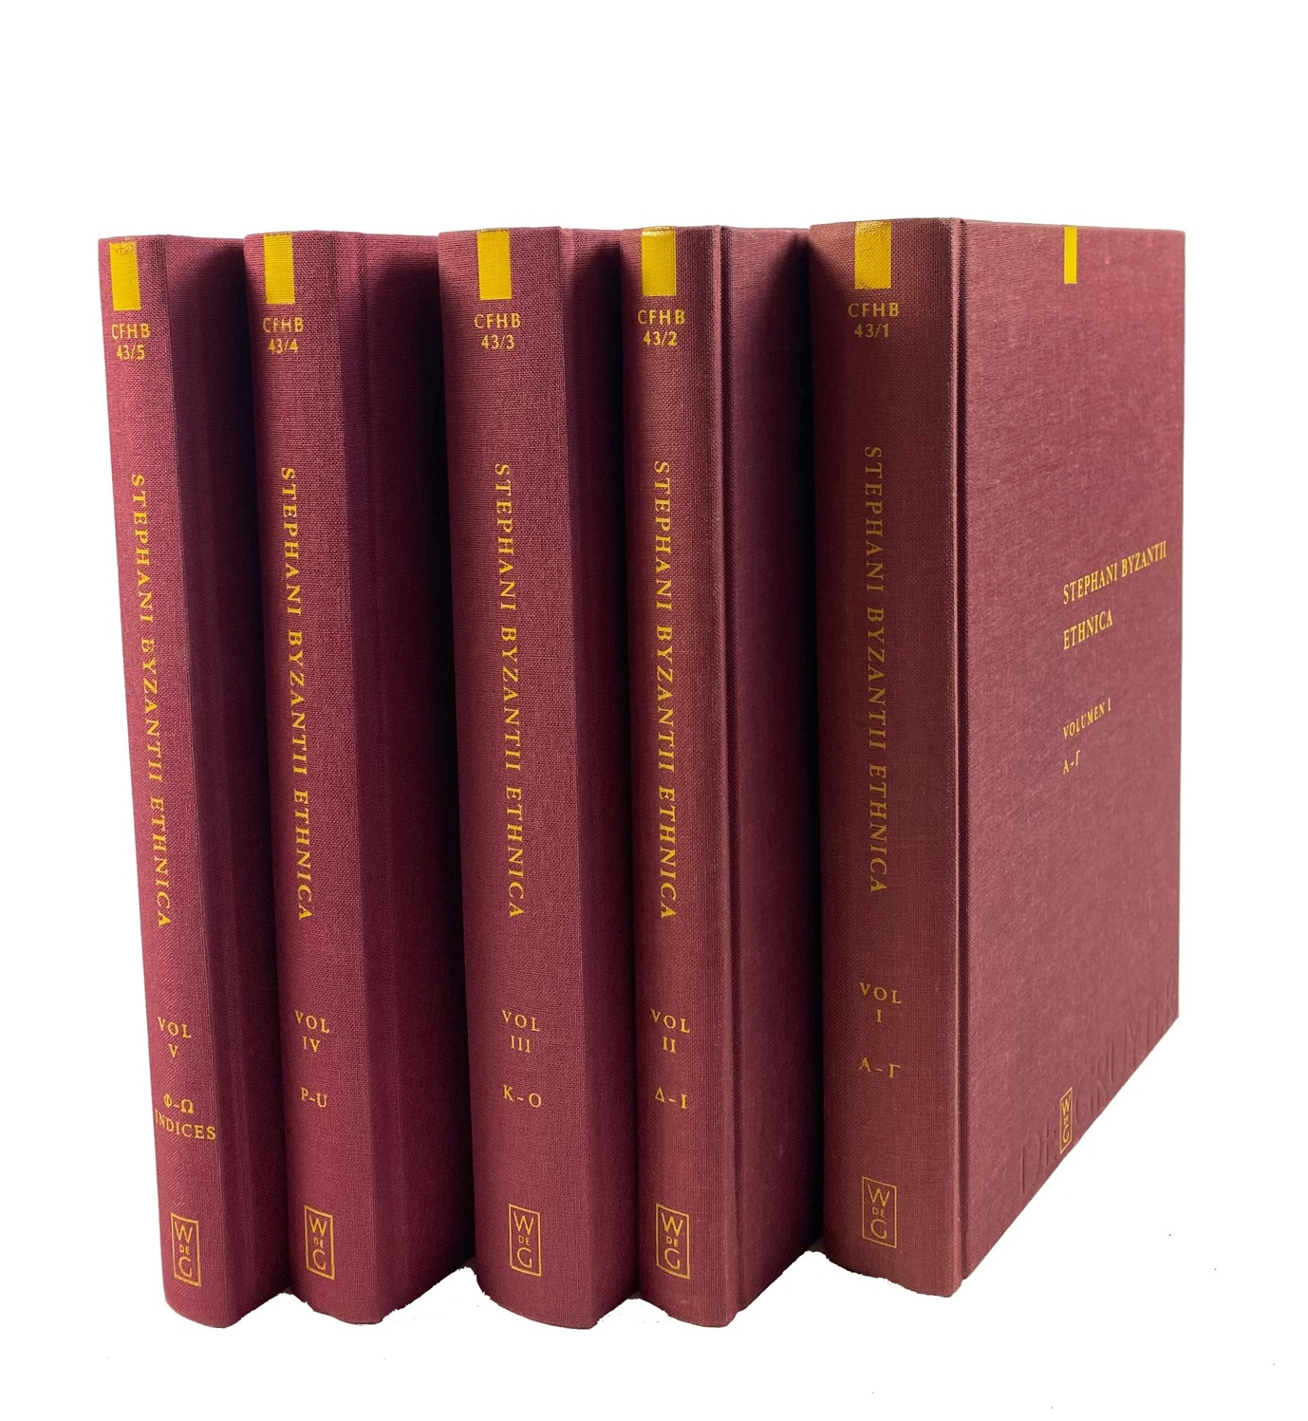
Fragments of Hecataeus’ Periodos Gês and Stephanus of Byzantium’s Ethnica

Slide 4

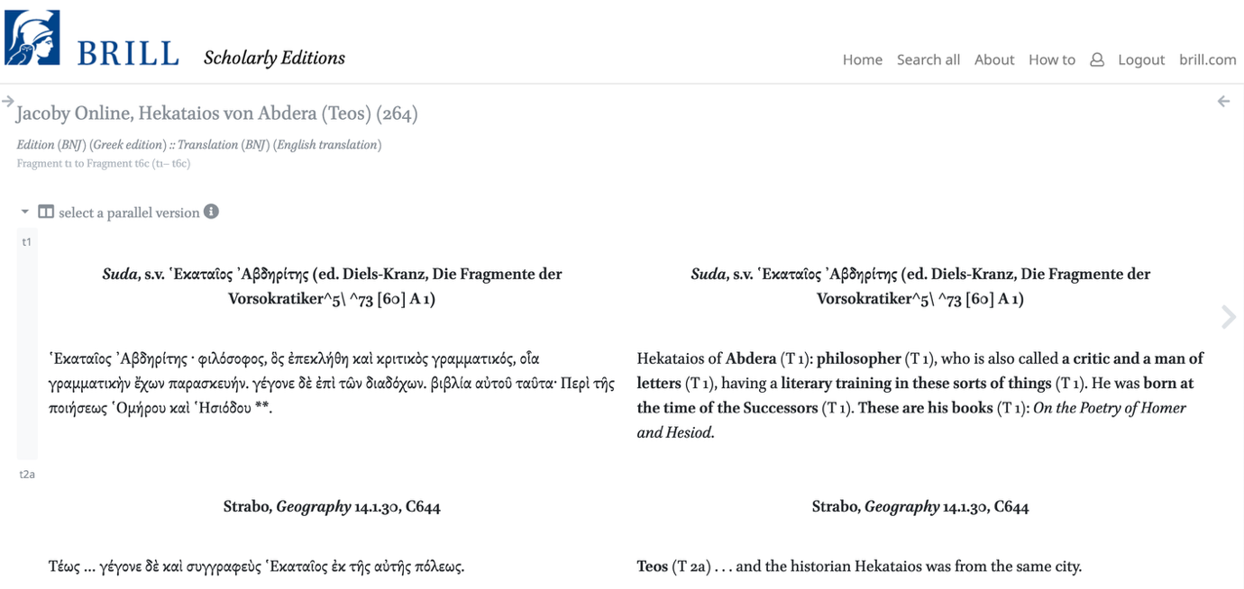
Hecataeus of Miletus or Hecataeus of Abdera?

Slide 5
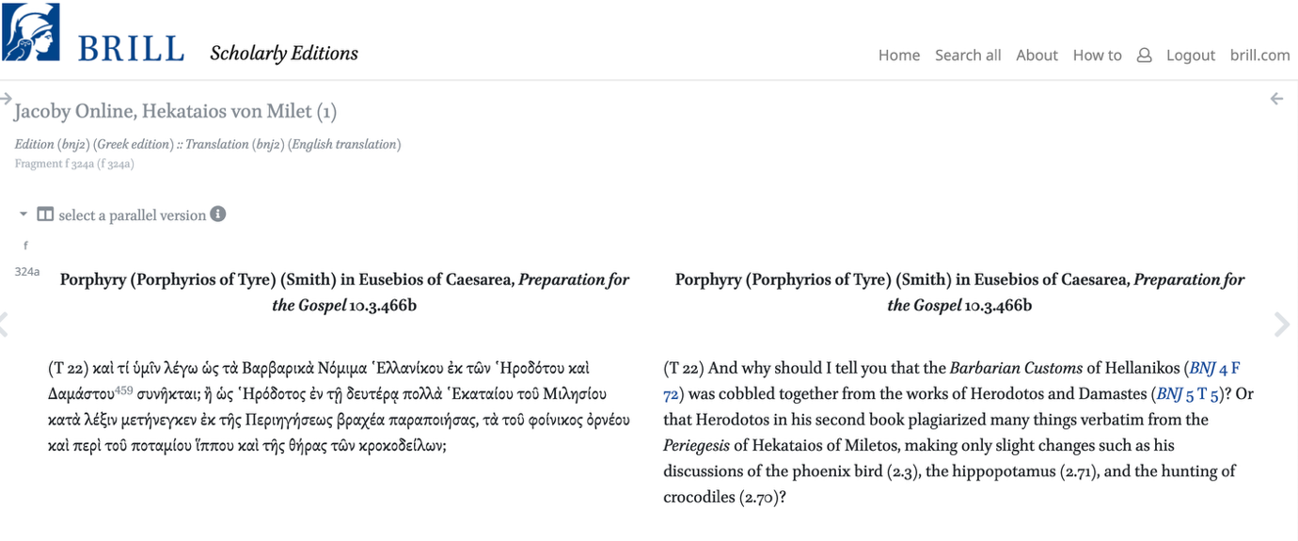
The Alleged Herodotean Plagiarism

Slide 6
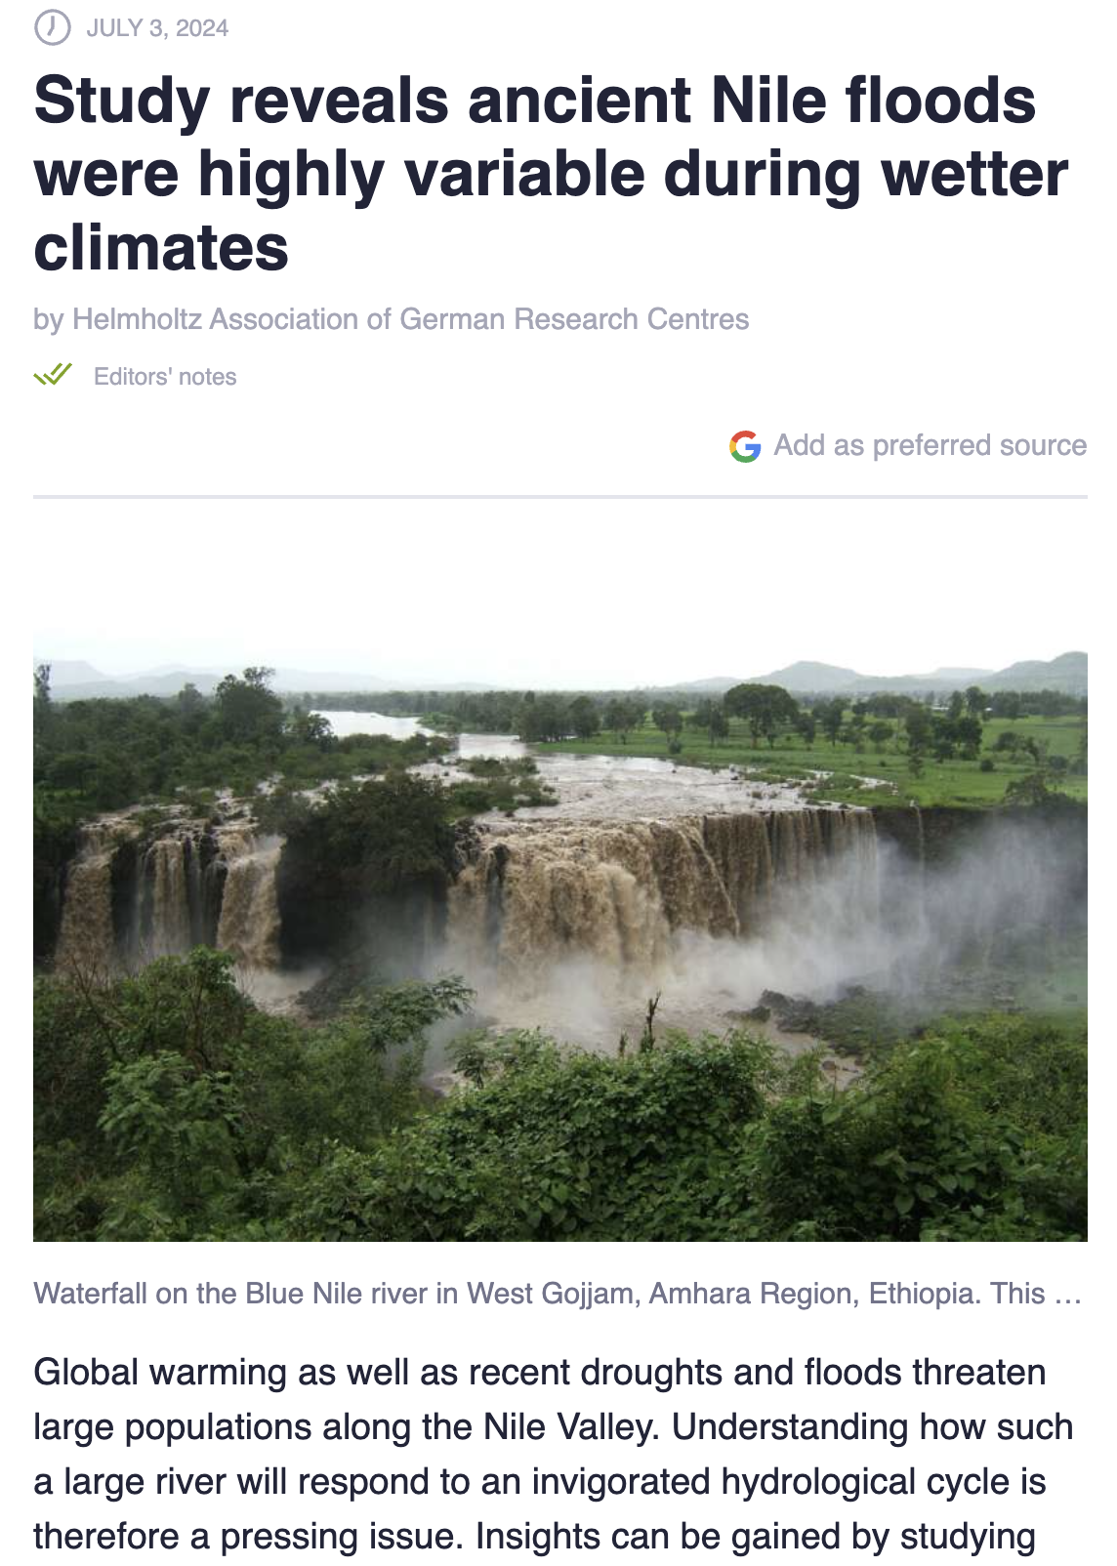
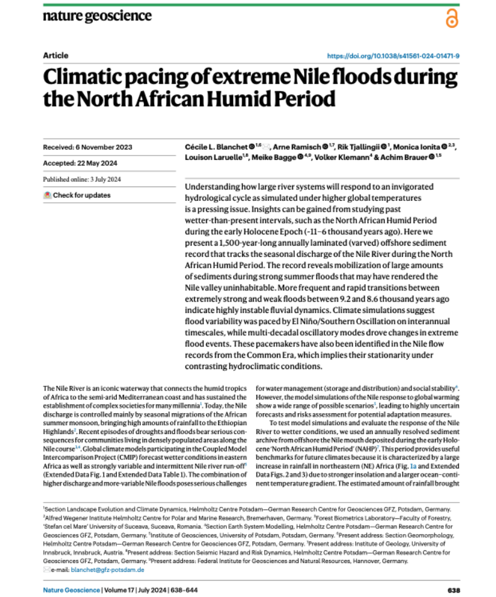

Herodotus on the Reasons for the Nile Flood

Slide 7
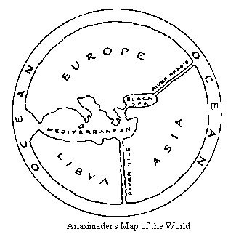

Map: Anaximander, Hecataeus, and Aristagoras

Slide 8
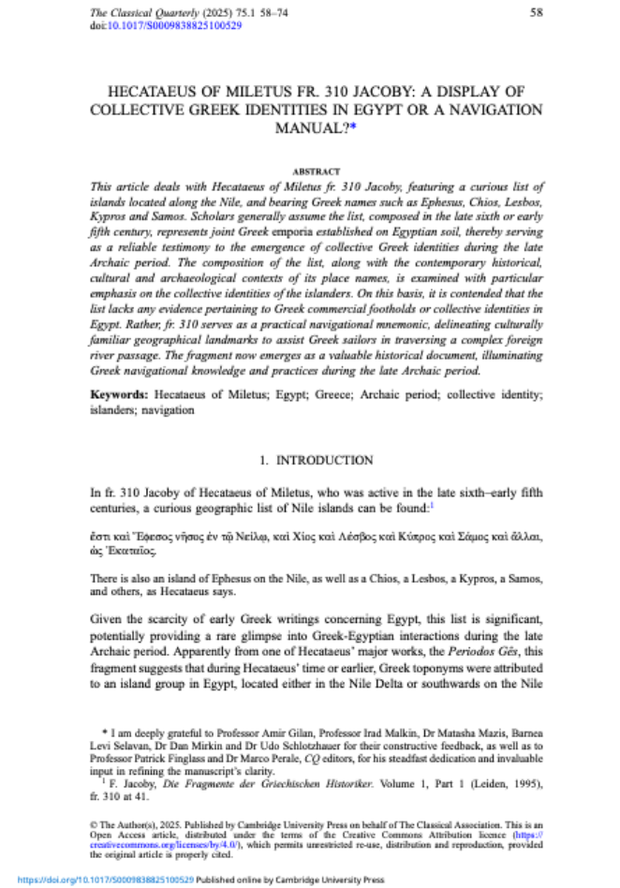
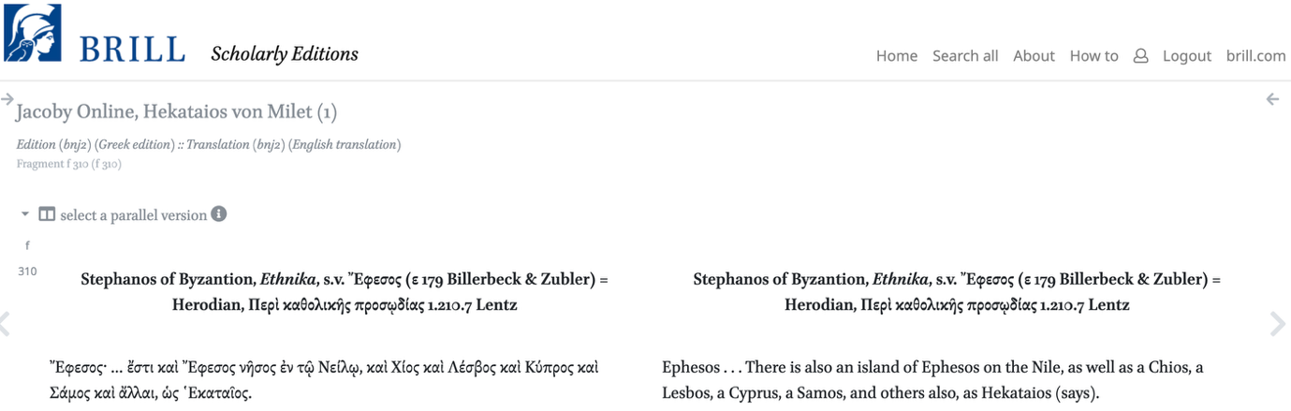
Hecataeus F 310: A Display of Collective Identities or A Navigation Manual?

Slide 9
Thanks for your attention!
Contact: ruobingxian@fudan.edu.cn

